Slide 1
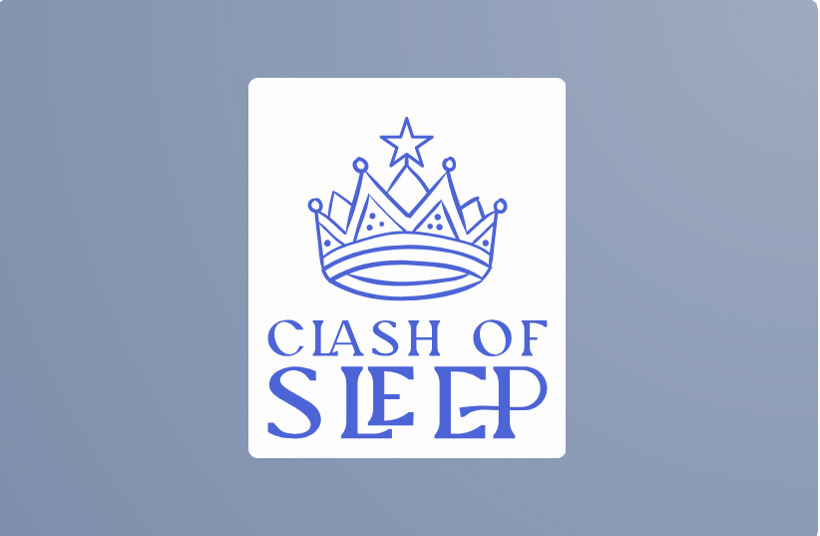
Unit 2 AOS 1:Innovative solutions
CLASH OF SLEEP
By Tristan,Nathaniel, Chauriya and Rafielalas
Notes:
Possible solutions:

Slide 2
1.0 Identified need
Target audience: High school students who struggle with getting up in the morning
Current setup: Phones - Kids stay on phones at night causing them to go to bed late
Problem: High school students not getting to school on time
Need: Make something that can help these high school students get to school on time

Slide 3
1.0 Proposed Solutions
Create an app that has the functions of an alarm but rewards the user with points that can be redeemed for skins on the users digital avatar and also include a leaderboard.
Create an app that tracks sleep patterns and acts as an alarm that can only be switched off when the user completes certain tasks (take photo of kitchen, math problems, speaking)
Create an app that plays audio depending on the depth of the user sleep. Eg: if the user is in deep sleep it will play and audio that would slowly speed up to wake up the user gently.

Slide 4
1.0 The Proposal
The solution: An app called ‘Clash of Sleep’ that promotes users to arrive at school on time.The features of this app are A leaderboard that tracks the users points and ranks them against other users, the app allows users to spend these points on skins on their digital avatars and also allow the users to create clans which they can compete against other clans in their area. The app includes Geolocation to stop users from cheating the system
Inspiration: Life 360, Google Maps and Alarm clocks

Slide 5
The UN Sustainable Development Goals (SDGs)
What are they?
Why do they matter?
Examples
17 global goals adopted by the UN to make the world fairer and more sustainable by 2030.
Our solution aligns with the SDGs because it promotes healthy sleep habits, which can improve physical and mental health.
Good Health (3), Quality Education (4), and innovation and infrastructure(9)
Good Health (GOAL 3)
Quality Education (GOAL 4)
Innovation and infrastructure (GOAL 9)
An app that can help users to wake up on time and it promotes productivity and time management.
The app allows users to be on time for school instead of waking up late and not being on time, which can affect their study.
Uses innovative AI technology to solve a real-world problem affecting teenagers.
Notes:
67

Slide 6
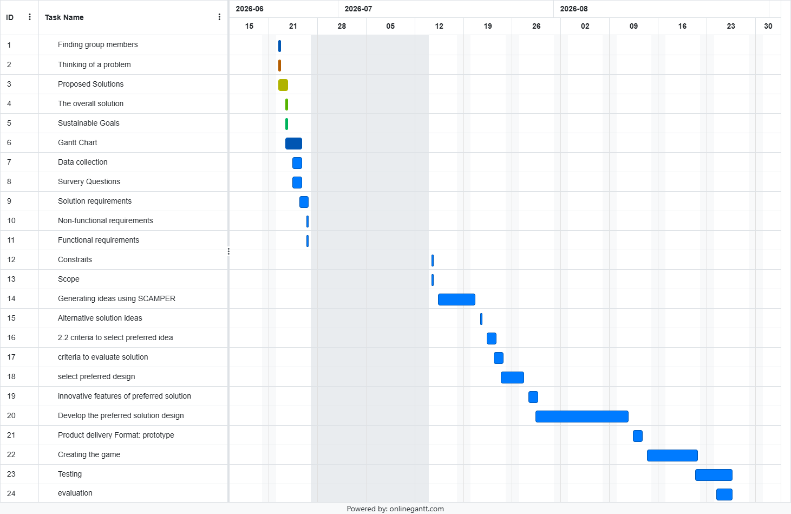
Gantt Chart

Slide 7
1.2 Data collection
Method used
We created and shared a survey with our IT classmates
The survey has multiple choice questions for quick and easy answers for the people responding to our survey
This method of using a survey helped us get data from our classmates to further upgrade our ideas.

Slide 8
1.2 Data collection
Data Collected
The biggest reason why students don’t wake up in the morning: Gaming,homework,sleep quality etc
Would people use an app that rewards you for waking up on time: yes, no probably,probably not
Which features would motivate the user to use our app: Leaderboards, Digital avatar customisation, Unlockable skins. Competing with friends Clan/team competitions, Daily Streaks, Achievement badges, Real rewards (giftcards, or discounts with the premium plan) ,Sleep tracking

Slide 9
Survey
Survey
https://app.base44.com/invite/link/DD9va7Wjmz6A

Slide 10
Functional requirements
User accounts and Profiles: The app must allow users to create an account and link it to their emails to store data points and rankings.
Alarm System: The app must let users set alarms so that they can get up early and complete their required tasks
Reward system: The app must award points for completing tasks and maintaining streaks
Leaderboard system: The app must display a global leaderboard ranking all users with points
Clan system: The app must display clans where you can join and participate in challenges to raise your clan
Geolocation and anti cheat: The app must use geolocation to negate cheating and confirm if the users has arrived at school
Data protection:The app must store user data securely and allow users to delete their account and data
User interface: The app must provide a dashboard showing sleep stats, points, avatar, next alarm, and clan status.

Slide 11
Non functional requirements
The app should load within 3 seconds.
The app should work on both Android and iOS devices.
The interface should be visually appealing and engaging.
The app should have a modern and responsive design.
The avatar should be be fully customizable.

Slide 12
constraints
Economic – $0 budget and 8 weeks to do
Legal – Privacy Act 1988 - transparency, access and correction, anonymity, marketing opt-outs. Copyright Laws.
Social – Teenagers or young adults still in school may find it hard to stick with the app
Technical – medium level coding skills, The app must work with phones or other mobile devices and avoid the need for advanced equipment
Usability – can be accessed by everyone with a phone, easy to use and understand

Slide 13
Scope
Inclusive: NFR 1,2,3,4 and FR 1,7,8
Excluded: NFR 4,5 and FR 2,3,4,5,6
For the start of this project the non functional and functional requirements that are selected a inclusive are within the budget the app is easy to use for the target audience and will be accessible on both android and ios.

Slide 14
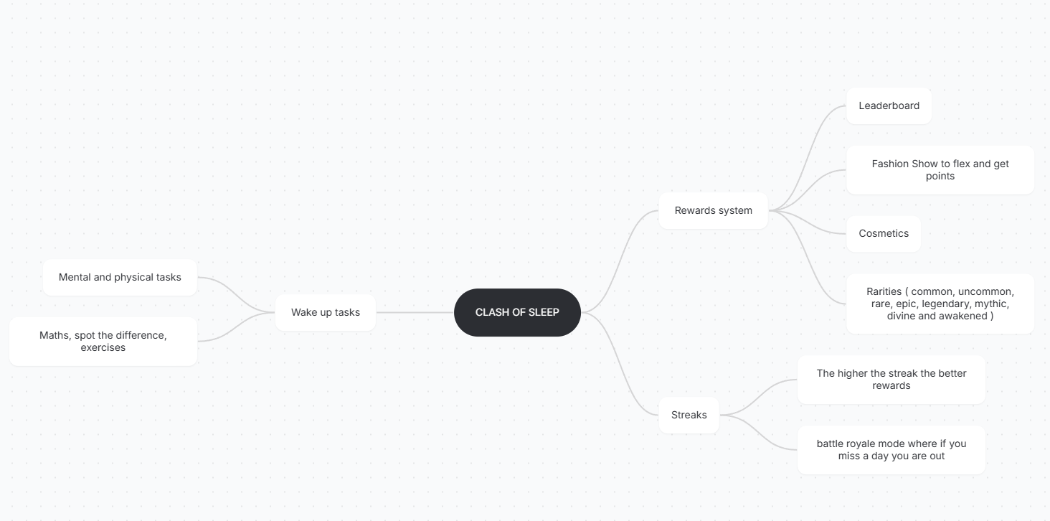
Mind Map

Slide 15
Scamper
Existing games/app | Environment | Scamper technique | New idea
Fortnite | Computer/console screen | adapt | Skins to add to your digital avatar by opening up loot boxes
Apex Legends | computer/console screens | subsitiute | So instead of using xp like in apex legends ours is based off completing quests to unlock lootboxes
alarm | Phone screen | adapt | Not only does it act as an alarm but only gives the user a task to at least get the user to become active and start their day

Slide 16
Alternate Solution Ideas
Dream Royale: Battle Mode
The first design idea for Clash of Sleep is a competitive battle‑royale style concept where users race to wake up faster than their friends. This version focuses on fast‑paced competition, using leaderboards, clan battles, avatar skins, and geolocation to verify school arrival. Every morning becomes a match, and users earn points by waking up early and completing tasks, which encourages punctuality through rivalry and game‑like mechanics.
Dreambound Adventure
The second design idea is a sleep‑quest adventure concept that turns healthy sleep habits into a progression‑based journey. Users complete daily quests, evolve their avatar as their sleep improves, unlock new map regions by arriving at school on time, and join guild‑style clans for cooperative challenges. This version emphasises long‑term habit building, exploration, and personal growth, making waking up feel rewarding and story‑driven rather than competitive.

Slide 17
Evaluation criteria
Evaluation Criteria (EC) | Functional Requirement (FR) | Evaluation Questions | Strategies
EC01 | User Accounts and Profiles – The app must allow users to create an account and link it to their emails to store data points and rankings. | Does the app allow users to register and log in securely? Are points and rankings saved correctly to each profile? | Test account creation and login on multiple devices; verify data is stored and retrieved accurately.
EC02 | Alarm System – The app must let users set alarms so that they can get up early and complete their required tasks. | Does the alarm activate at the correct time? Are tasks required to turn it off? | Set multiple alarms; test each task type (photo, math, speaking) to confirm proper functionality.
EC03 | Reward System – The app must award points for completing tasks and maintaining streaks. | Are points awarded consistently after each successful wake-up? Are streaks tracked correctly? | Simulate daily wake-ups; check point totals and streak progression in user profiles.
EC04 | Leaderboard System – The app must display a global leaderboard ranking all users with points. | Does the leaderboard update accurately and fairly? Are rankings visible to all users? | Compare test accounts; verify leaderboard refreshes after each event or point change.
EC05 | Clan System – The app must display clans where users can join and participate in challenges. | Can users join, leave, and interact with clans easily? Are clan scores updated correctly? | Create test clans; run mock challenges; confirm data sync and clan ranking accuracy.

Slide 18
Criteria to select Preferred idea
Development time - Can the game be created within the 6-week timeline?
Resources required - Does the game fit within the $0 budget and available resources?
Number of players - How many players can actively participate at the same time?
Encourages physical activity - Does the game get players moving and engaging physically?
Scalability - Can the game easily grow or adapt in the future?
Ease of Implementation - How easy is it to develop the game with the current skills and technology?
Maintenance costs - How much will it cost to maintain and run the game in the long term?
Ease of use - Is the game simple for players to understand and enjoy?
Hardware/software compatibility - Can the game run on existing devices or technology?
Future modifications - How easily can the game be updated or improved in the future?

Slide 19
Preferred design
The preferred design is Clash of Sleep

Slide 20
Onboarding Questions
Raf: having trouble in the morning, feeling bored and tired well become energetic and alert today by beating your friends by beating them in this app
Chaurya: Do you want to vs your friends while sleeping then this app if for you.
Tristan: Who controls their alarm better, you or your friends? Prove yourself in our App, rise to the top and push through to victory.
Nathaniel : having trouble waking up in the morning, beat your sleep and beat your meat in this competitive ranked battle royale where you clash with your friends and beat them by waking up in faster.
Notes:
Nathaniel 4 raph 1

Slide 21
Preferred Onboarding question
Having trouble waking up in the morning, beat your sleep and beat your meat in this competitive ranked battle royale where you clash with your friends and beat them by waking up in faster.

Slide 22
Ipo chart
Input | Process | Output
User creates an account and profile | Store user information securely | User profile is created
User enables location (GPS) | Verify the user's arrival at school using geolocation | Attendance is confirmed only if the user is at school
User arrives at school on time | Award points for on-time arrival | User earns points
Points earned | Update the user's total score | Increased point balance
User points | Update the global and local leaderboard | User's ranking is displayed
User spends points | Deduct points and unlock avatar skins | New avatar skins become available
User creates or joins a clan | Add user to clan database | Clan is created or joined
Clan members earn points | Combine member scores and compare with other clans | Clan rankings are updated
GPS location and timestamp | Check for invalid locations or fake GPS use | Prevents cheating and ensures fair play
Leaderboard data | Rank all users and clans based on points | Competitive rankings encourage users to arrive on time

Slide 23
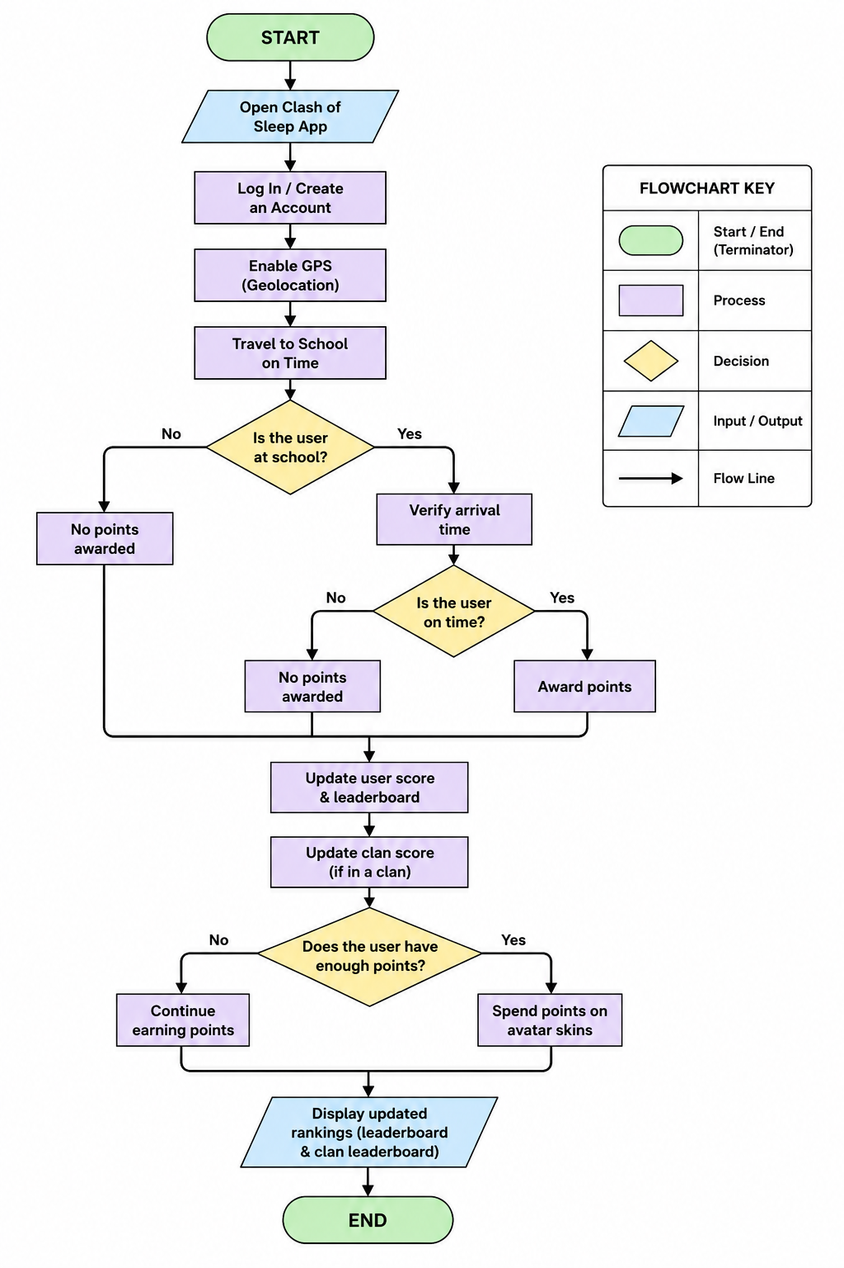
Flow chart

Slide 24
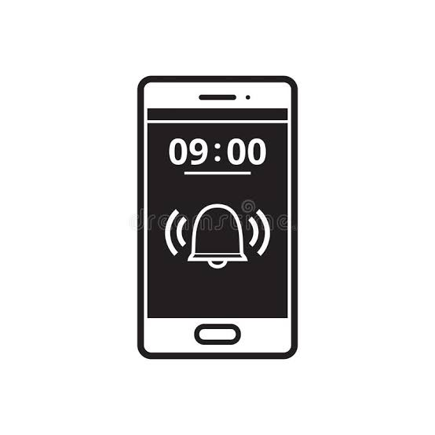
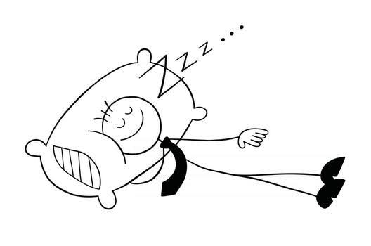
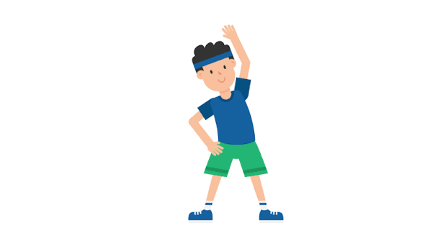
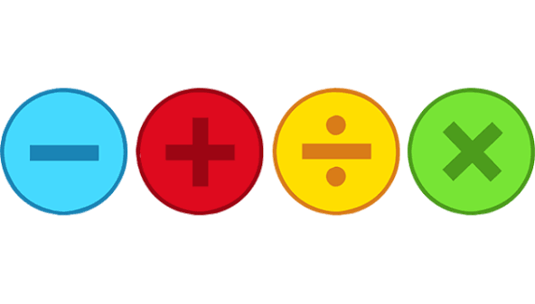
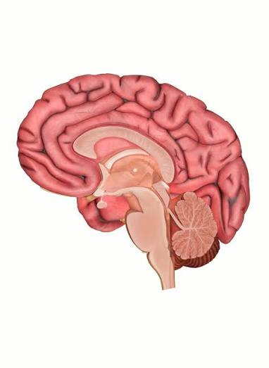

Annotated Diagram
Clash of sleep alarm goes off
Person Sleeping
Perform wake up activities to turn the alarm off
Alarm goes off

